Slide 1




SRC Poster Workshop: Social Sciences
March 19, 2024

Slide 2
Overview
The Building Blocks of a Poster
Writing Tips
Formatting
Example
Poster

Slide 3

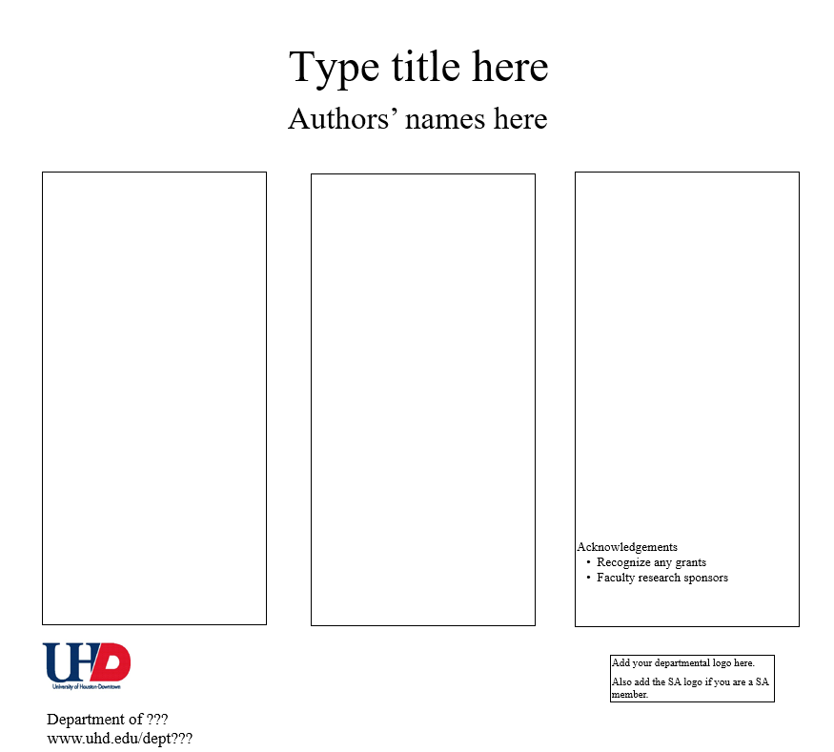
The Building Blocks of a Poster
Download the template
  Available here.
Begin planning your sections
  *Abstract
  Background
  Methods/Procedure
  Results
    *Figure or Table
  Discussion
  References
  Acknowledgements
*Abstract
Results
Discussion
Background
References
*Figure or Table
Method
Notes:
*Abstract
Brief summary of entire project
Background
Key background information for your project.
What is your research question?
Methods/Procedure
Key methods, measures, and procedures used.
Results
What did you find?
Discussion
What do your findings mean?
References
List any work referenced in the poster. Should use the format of your field (e.g., APA).

Slide 4

Writing Tips
Posters are a unique genre of scientific writing.
  Include all sections of a scientific report distilled to key points.
  Take time to do well.
Follow guidance from your faculty mentors.
  Who are the authors? What order should they be listed in?
  Are there any grants that you need to acknowledge?
  Use their feedback on your drafts to improve the poster.
Begin writing your sections in a word document.

Slide 5

Writing Tips
Background
  Needs to provide key information for understanding your project.
  Should be accessible. Don’t assume audience is familiar with your topic.
  Should include a clear statement about your main hypothesis or research question.
  Organization
    Can write this section as a paragraph or use bullet points.
    Will depend on the project, but I recommend 3-5 bullet points

Slide 6

Writing Tips
Method
  What steps, measures, or procedures did you use for your project?
  Should be clear enough that the audience will understand how you conducted your research.
  Depending on the kind of research conducted, you should describe your
    Sample
    Key measures
    Procedure

Slide 7

Writing Tips
Results
  What did you find?
    Explain how you conducted your analyses
    Explain the results
  Should include a figure or table as a visual aid*

Slide 8
Writing Tips
Discussion
  Overall, did your findings support your hypothesis?
  Were there any important limitations of your findings?
  What next steps should researchers take?
References
  List all cited references in the poster.
  Use the format of your discipline (e.g., APA in Psychology)
Acknowledgements
  Thank contributors who helped with the work but aren’t authors.
  List any research funding sources.

Slide 9
Formatting
Once you’ve written and edited your project information, it’s time to add it to the poster template.
SRC Requirements:
  Use the template (40 inches x 44 inches) and a white background
  If using color images, do not heavily darken them.
General guidelines
  Use a single, professional font style for the entire poster (e.g., Times New Roman, Calibri, Arial).
  Use large font sizes for accessibility (e.g., 30 pt and larger)
  May use 1-2 other colors as small accents

Slide 10
Example Poster

Slide 11

Resources
Scribbr for creating accurate APA references
Purdue OWL for reference guidelines
Psi Chi resources for poster presentations
SRC resources for poster presentations

Slide 12

Questions?

